Slide 1


Learnora
~ Learning Simplified

Slide 2
INTRODUCTION
Problems faced:
Lose focus during long lessons
Hard to understand difficult topics
Lack immediate support outside classroom hours – reduced learning efficiency
Non-personalized information
Rely on generalized teaching methods – hard to provide equal attention
Traditional learning methods use a one-size-fits-all approach that does not meet individual student needs

Slide 3
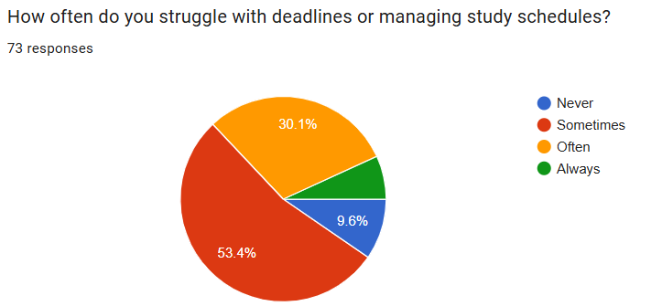
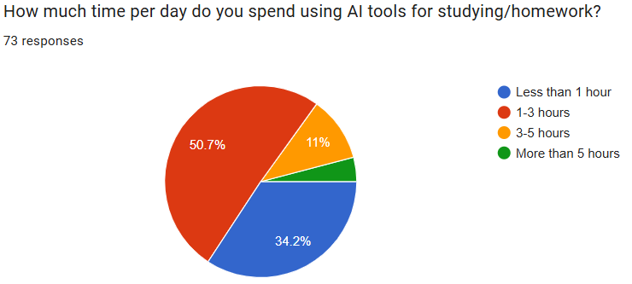
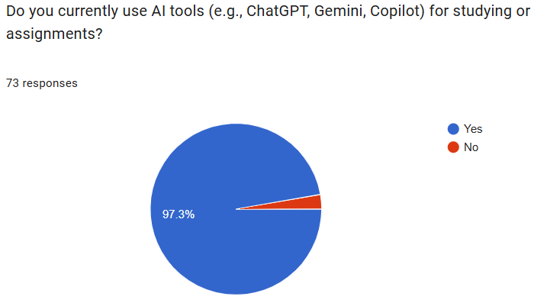
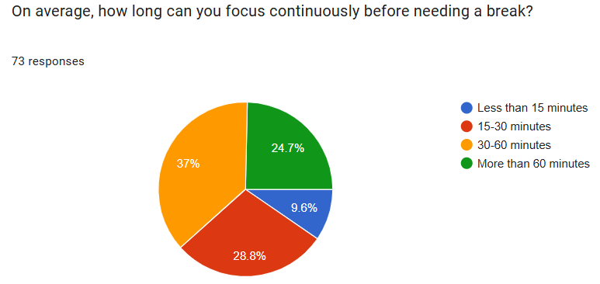
Face challenges in time management & student organisation
Structured learning support- stay on track
Comfortable using AI technology
Learnora combines AI features into one focused educational system
Lose concentration during long study sessions
Learnora's method is more engaging & interactive

Slide 4
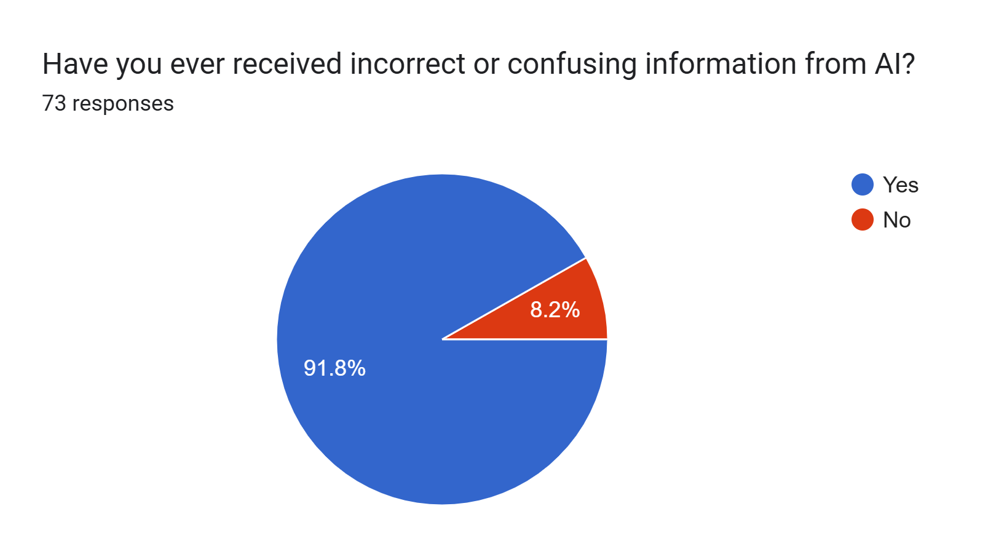
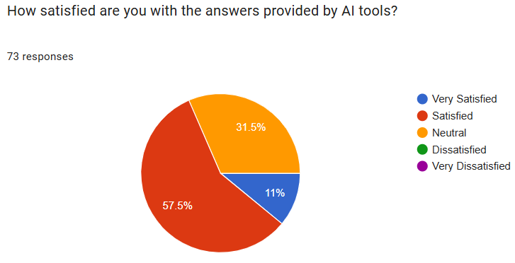
General AI purposed tool
Not specified for learning and education
Doesn't meet the expectations of the students

Slide 5
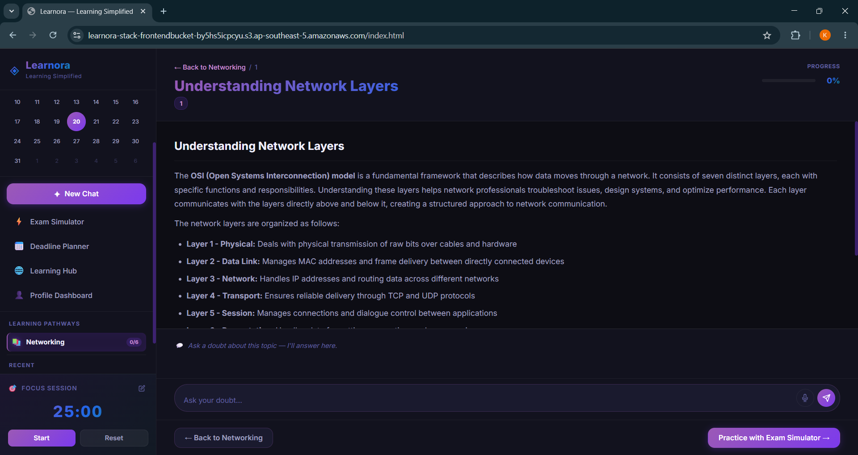
Our Solution? Meet Learnora: AI-Powered Learning Simplified
Key Features:
1. Personalized Learning Pathway
2. Smart Deadline Planner
3. Al Study Assistant
4. Exam Simulator
5. Focus & Productivity Support
6. Unified Learning Platform

Slide 6
Why AI is essential globally?
Traditional Learning Platforms
❌ Generic learning systems
❌ Static recommendations
❌ Overwhelming information
❌ Limited personalization
Learnora Helps By:
✅ Natural language interaction
✅ Smart ontext-aware planning
✅ Personalized study support
✅ Adaptive learning experience

Slide 7
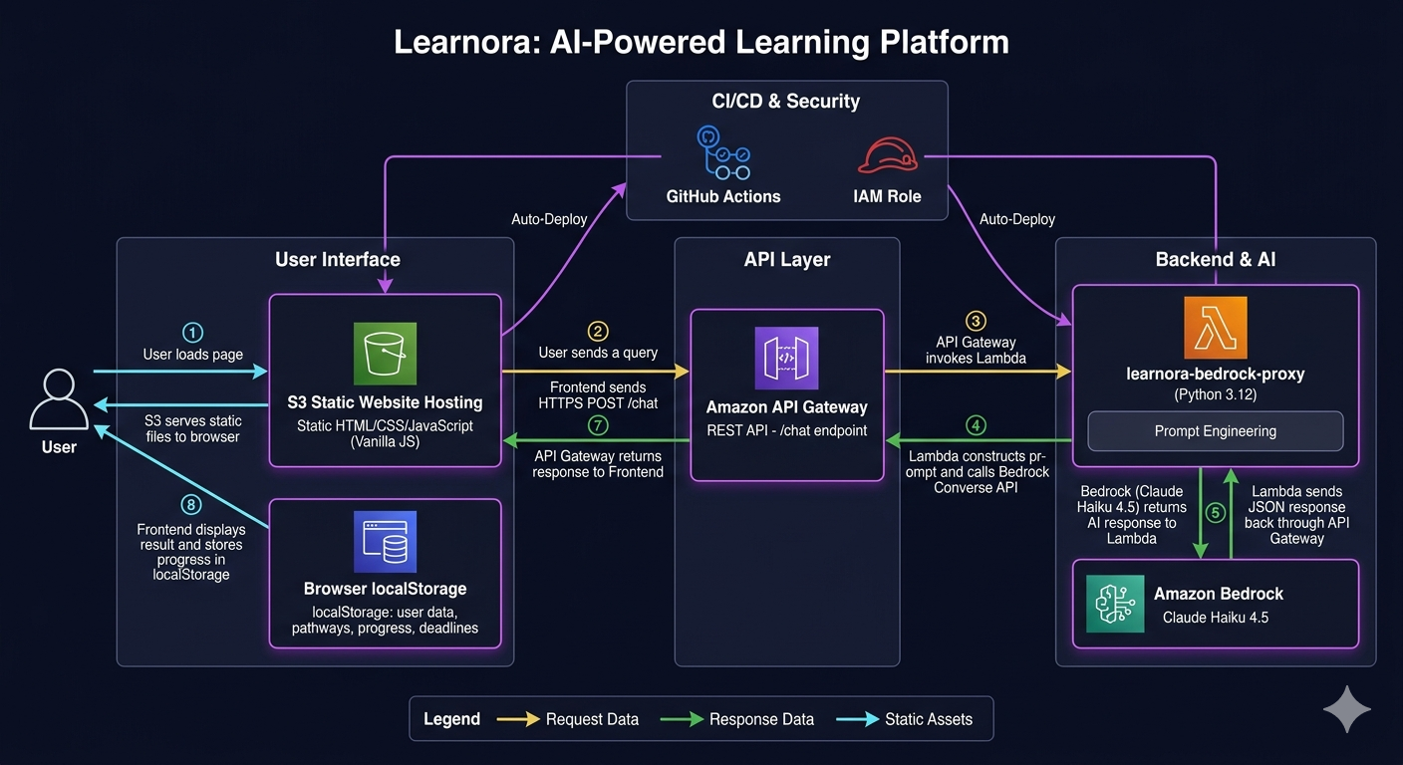

Architecture of Learnora

Slide 8
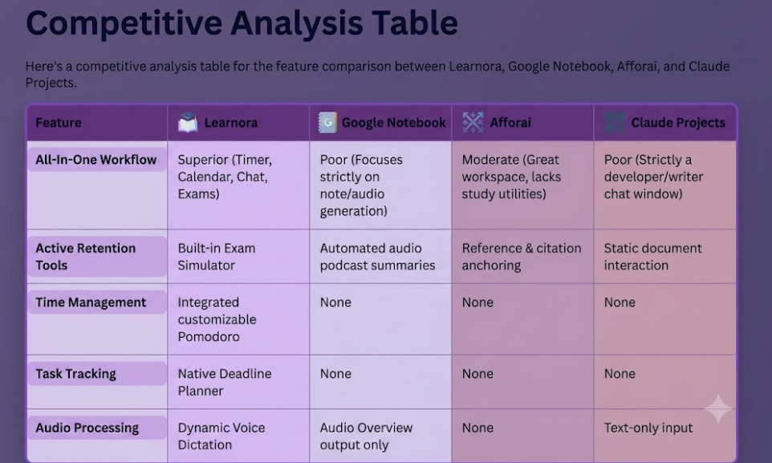


Slide 9
Impact of Learnora
Individual Impact (Household)
🎓Personalized learning experience
🤖AI support anytime, anywhere
⏱️Improved focus and productivity
Institutional Impact (Commercial)
🌐Scalable AI learning ecosystem
🏫Integration with schools/universities
📊Data‑driven insights for educators
🌐 Multilingual access
🎧 Advanced learning
🏫 Institutional integration
Future Vision

Slide 10


Why Learnora ?
Smart (AI–powered)
Scalable Innovation
Adaptive Learning
Smart
Scalable
Adaptive
“Where technology doesn’t replace learning, but improves the way students understand, engage, and grow through learning.”

Slide 11


